Slide 1
Psychology Research Database
Created by Aaron Branham, Joel Branham, Jobish Mathew, and Kristen Burger

Slide 2
Purpose
Keep track of research participation credits earned by psychology majors and minors

Slide 3
Requirements
The database should be available on-line.
Only approved faculty should be able to view and modify (i.e. data entry) the entire database.
Each student should have the ability to view (but not modify) his or her record (but not other students’ records).
The database itself should contain the following information:
Student name and email.
Major in psychology or minor in psychology.
Studies participated in.
Total research credits earned.
Bonus Requirements
Students can view and register for available studies
Researchers can post and modify schedules (available times) for each study (but their own)
Available times would need to update automatically as students registered for a particular study and time, or canceled

Slide 4
Project Structure
Java Servlet Hosted on Tomcat Server
Connected to SQL Database

Slide 5
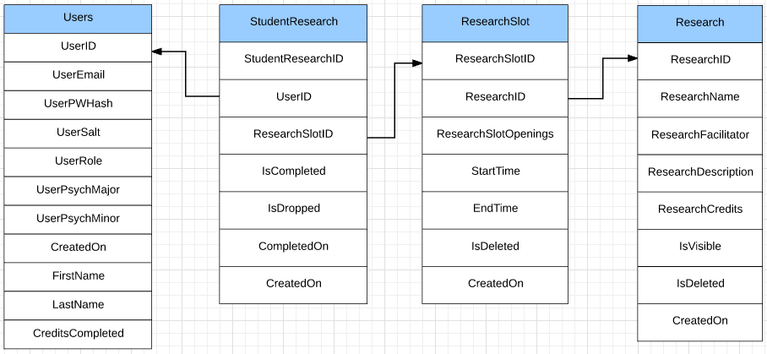
Database Structure

Slide 6
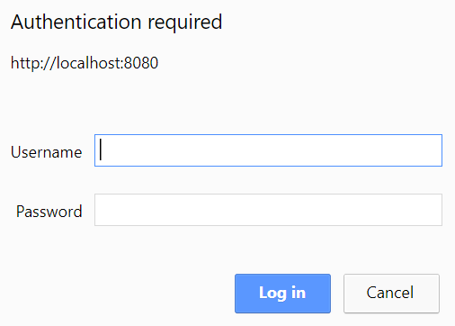
Project Flow
Login
Administrator
Professor
Student

Slide 7
Administrator
Functionality
Sees ALL users data
View particular user
Query for all user data:
Query for researchslotid from searched user:

Slide 8
Professor
Functionality
Sees only students data
View particular student
Functionality currently same as Administrator (except for user viewing)

Slide 9
Student
Functionality
Only sees their data
Can register for research
Query to view information about the research the student is currently enrolled in:
Query to decrement the slot openings for the research that the student just enrolled in:
Query to make new studentresearch record:

